Slide 1
BLIND SQL Injection USING AUTOMATON TOOL/ SCRIPT
Assignment 1

Slide 2

Information Schema
INFORMATION_SCHEMA serves as a centralized repository that stores metadata about other databases, detailing structures like tables, columns, and indexes.
By querying the INFORMATION_SCHEMA, users can obtain a plethora of details, including table names, column data types, constraints, and even information about stored routines and triggers.
It offers a consistent and standardized method to retrieve database information across different relational database management systems, ensuring uniformity in metadata queries.

Slide 3

Blind SQL Injection
Blind SQL injection is a type of SQL injection attacks where the attacker determines database information through true/false questions, based on the application’s feedback. This method is used particularly when the application hides specific error messages yet remains open to SQL vulnerabilities.

Slide 4

Brute Force Attack
A brute-force attack consists of an attacker submitting many passwords or passphrases with the hope of eventually guessing correctly.
Systematic check of all the possible passwords or paraphrases until the attacker finds the right one.
In our case we will check character by character.

Slide 5
Automation
Navigating extensive databases manually can be time-consuming; automation offers a streamlined approach.
Automated scripts eliminate the need for constant human oversight, speeding up data processing.
Merging Blind-SQL Injection with Brute-Force Attacks optimizes password extraction from database schemas.
A Blind-SQL Injection technique combined with a Brute-Force Attack Tools like Python scripts are pivotal for automation, ensuring efficient data retrieval and server validation.

Slide 6
Automation LOGIC
FUNC(str):
Initialize headers
create a payload with given str
requests.put()
for i in alphabets:
if ”already exists please try to register with different username”:
validate if the guessed name is the name and add to list
FUNC(modified str)
else:
return
FUNC(“”)

Slide 7
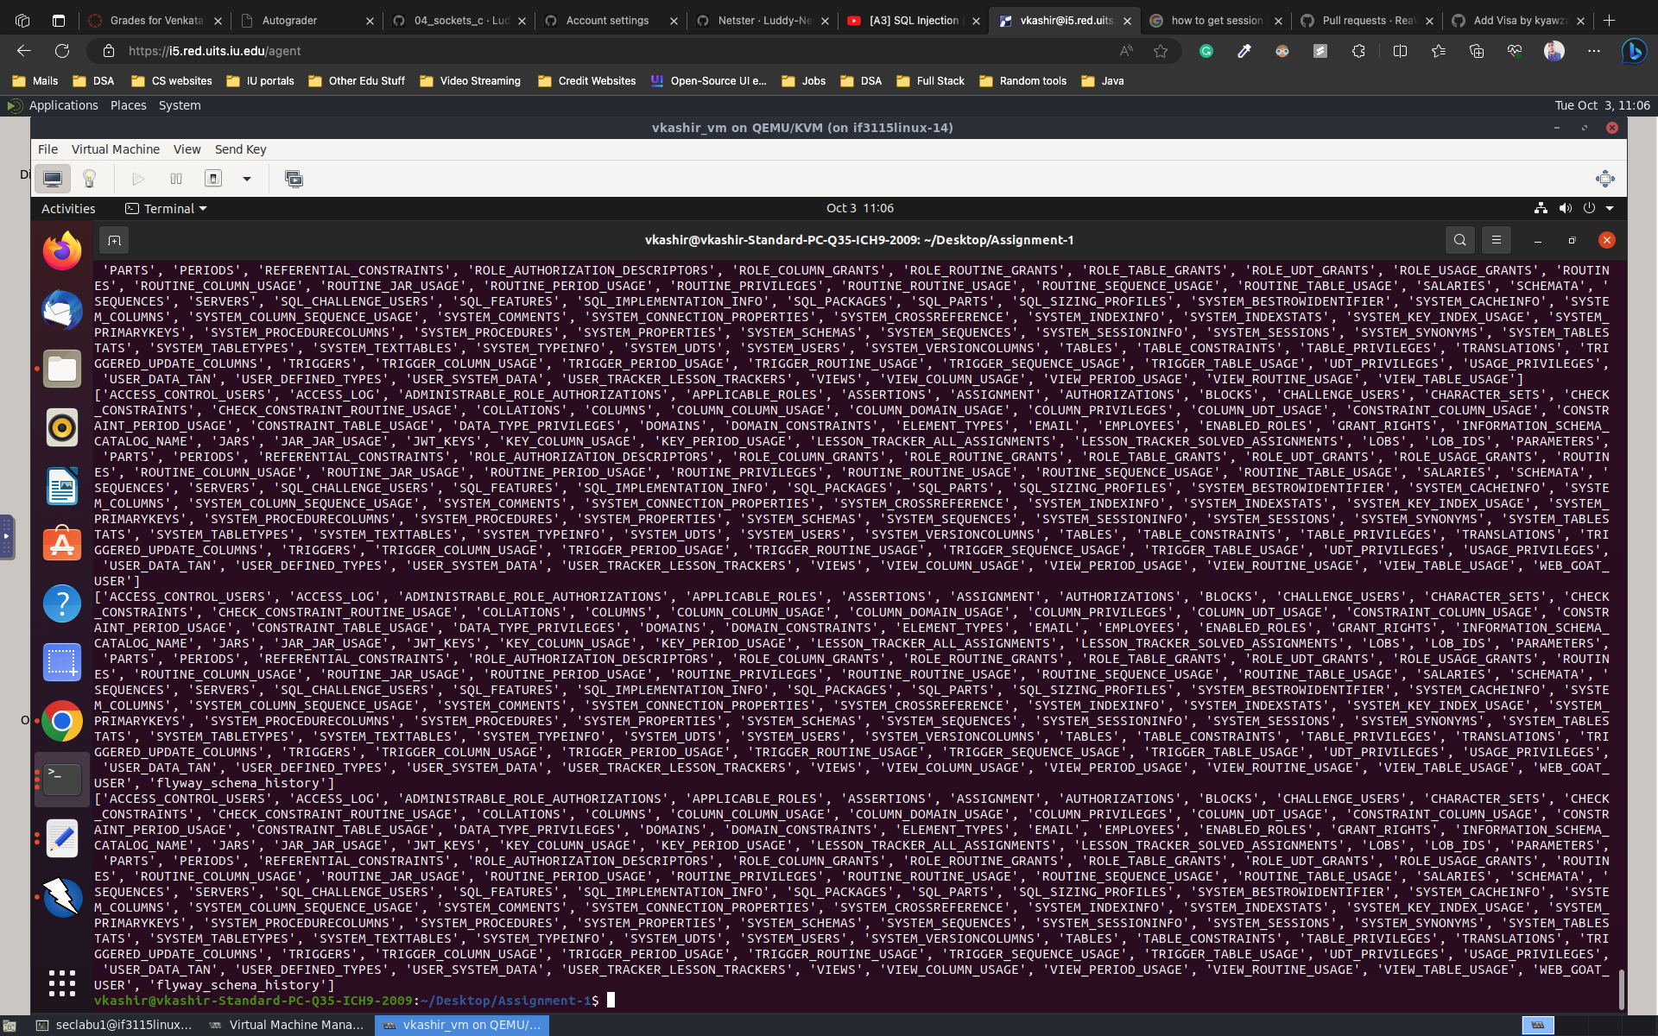
Table names

Slide 8
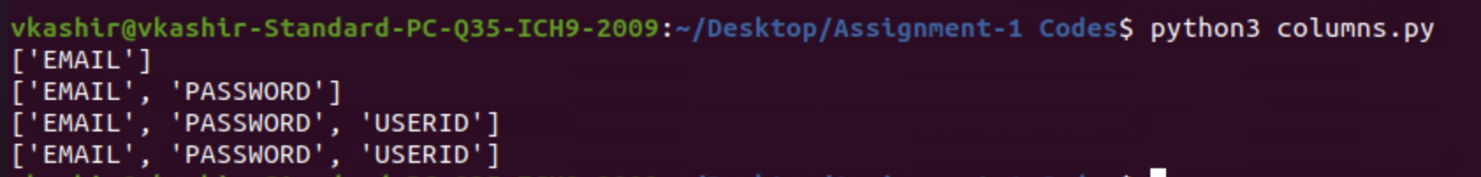
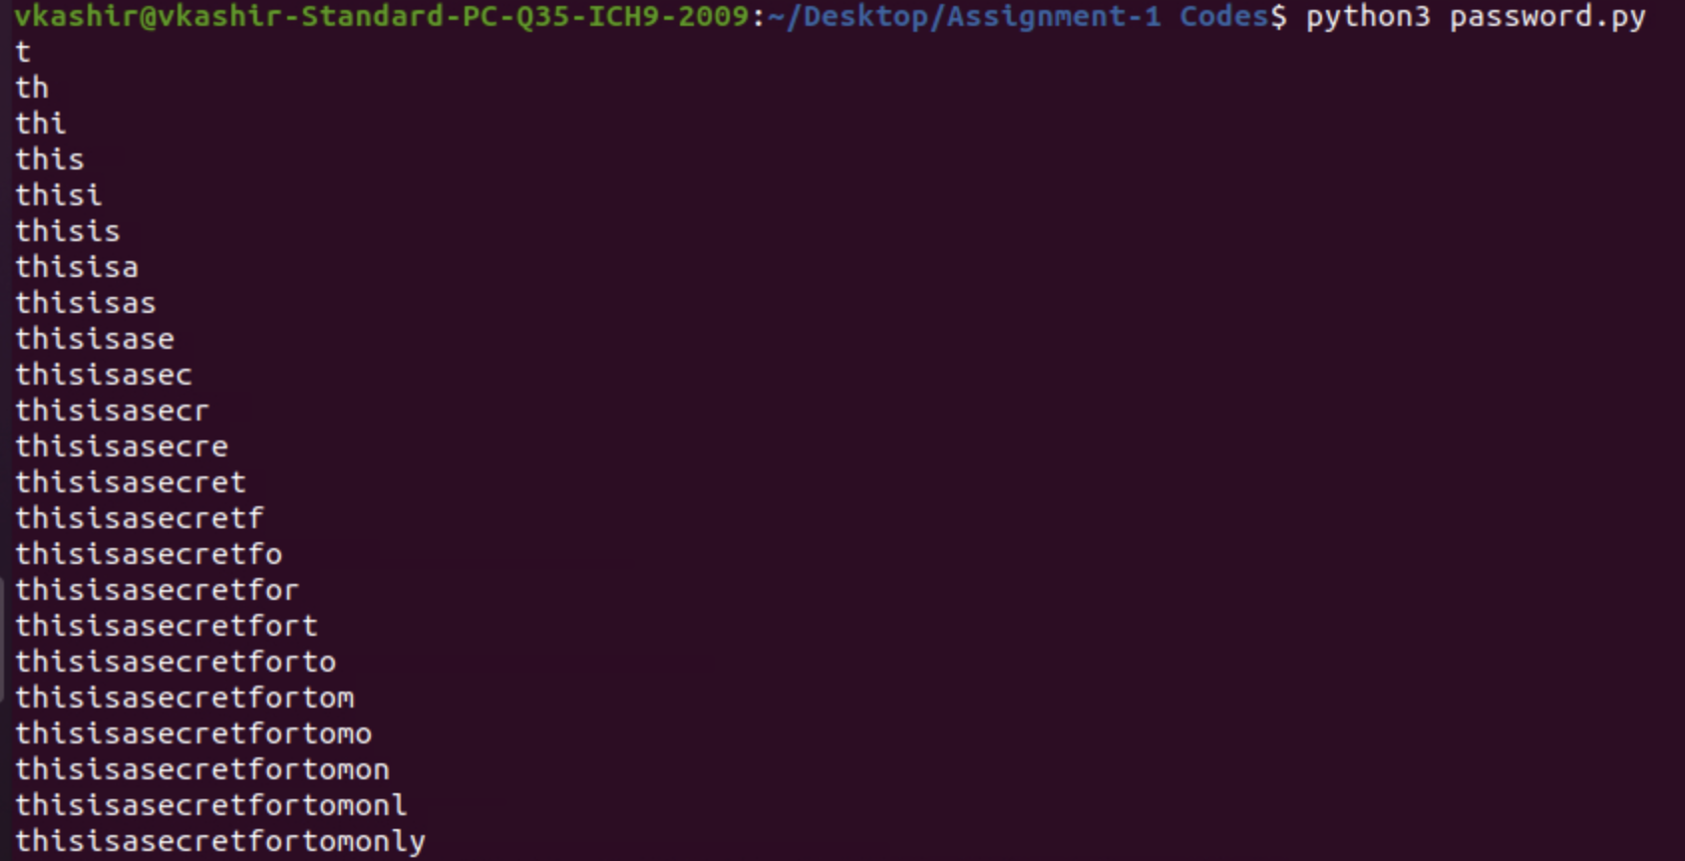
COLUMN NAMES
USERNAMES
TOM’S PASSWORD

Slide 9
Video link:
https://youtu.be/qB0i4E6nNZ4

Slide 10
THE END

